Slide 1
Product Development
From the Product Management Perspective
8/22/2013 - SoTechie

Slide 2
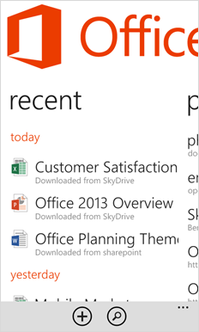
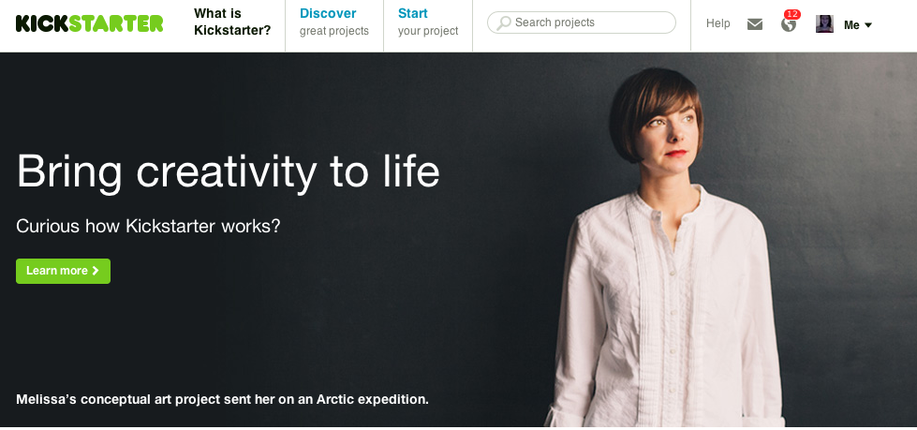
Ellen
@ellenchisa

Slide 3
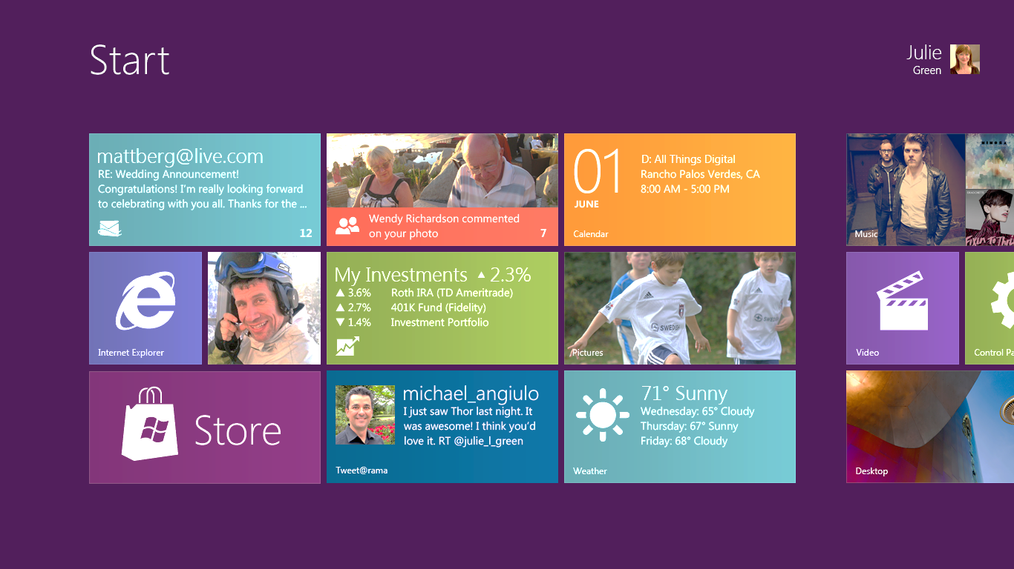
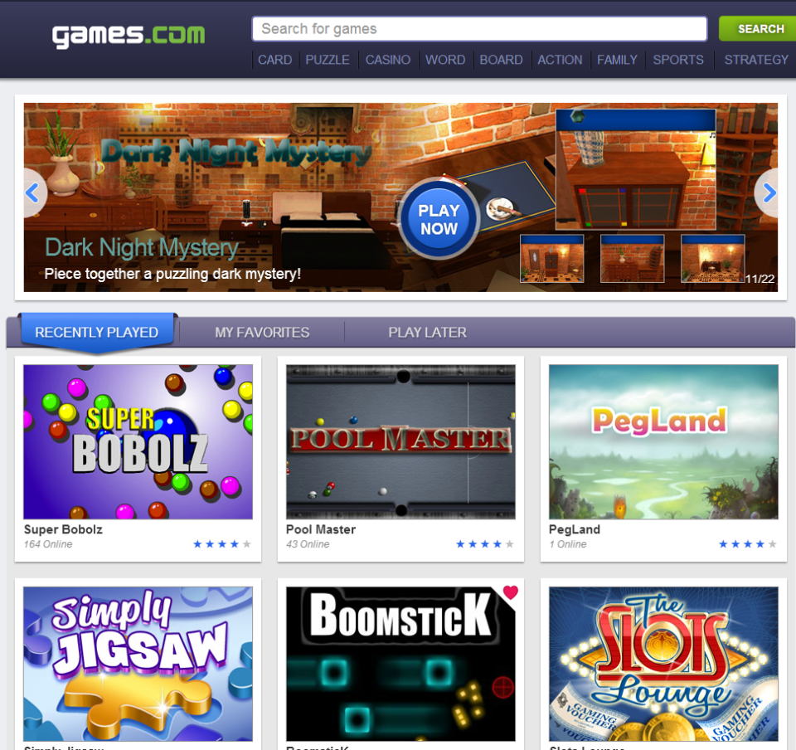
Steven
@sbenario

Slide 4
Our Goals
AKA - “what we want you to walk away with”

Slide 5
You’ll learn
1. What is a PM?
2. Five Microsoft PM techniques that you can use
GOALS

Slide 6

The 1st Rule of “What is a PM?”
There are no rules.
PMs are different at every company, and in every role

Slide 7
5 PM Tools and Techniques
1-Pagers
Scenarios
Specifications
Project Management
QA / Test
GOALS

Slide 8
Process

Slide 9

Microsoft Process

Slide 10
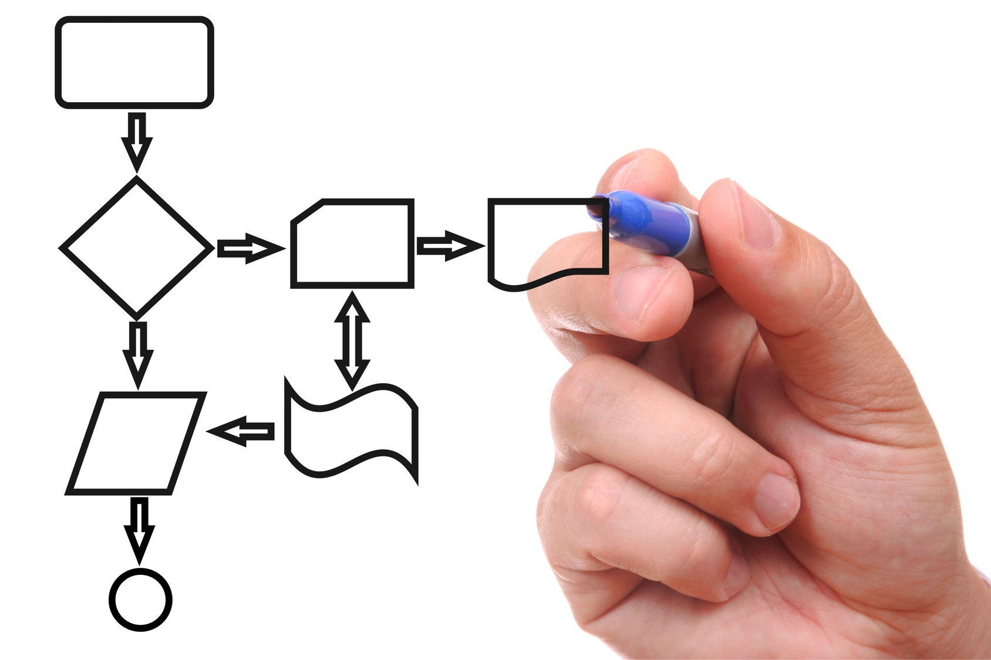

Slide 11
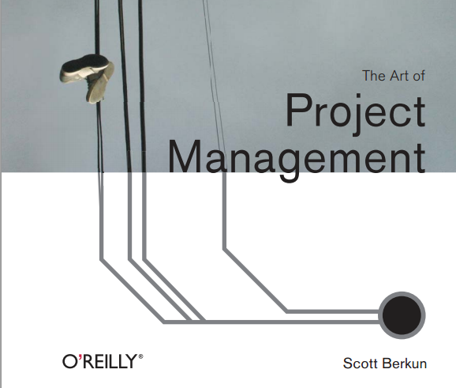
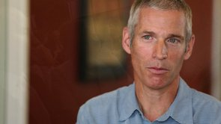
Why PM?

Slide 12
A Model for PM
Strategy
Project Management
UX / Problem Solving

Slide 13
A Model for PM
Strategy
Project Management
UX / Problem Solving

Slide 14
A Model for PM
Strategy
Project Management
UX / Problem Solving

Slide 15
1-Pagers
(Or “page one specs”)

Slide 16
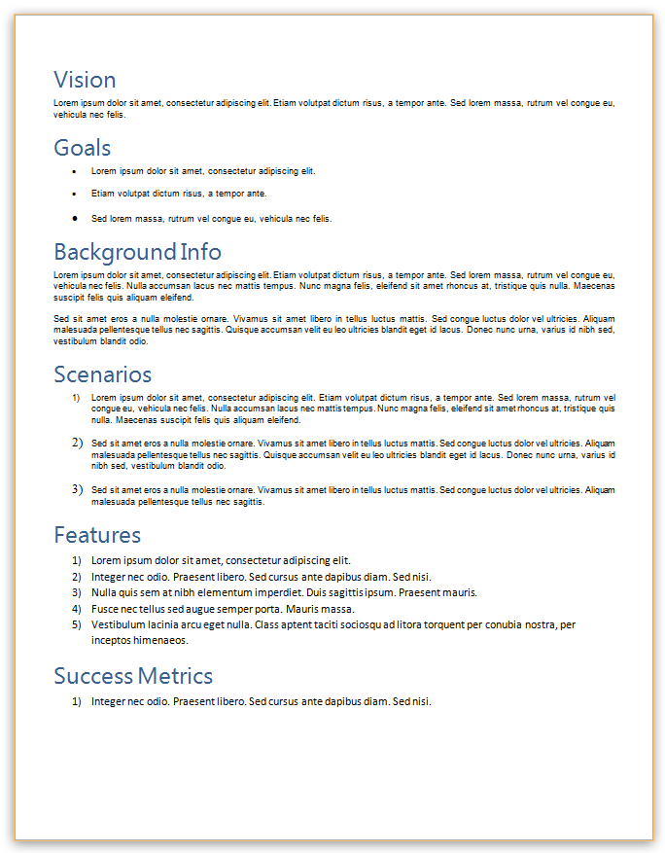
Structure of a 1-Pager
Vision
Goals
Background
Scenarios
Feature List
Success Metrics
1-PAGER

Slide 17
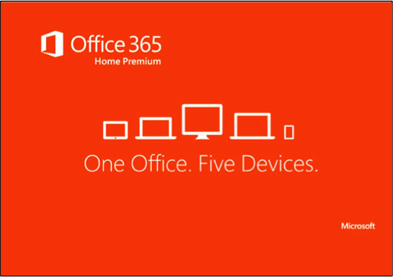
Vision
“Office everywhere.”
1-PAGER

Slide 18
Goals & Non-Goals
Access documents from any device.
Edit documents from any device.
Create documents from any device.
Full desktop Office parity.
1-PAGER

Slide 19
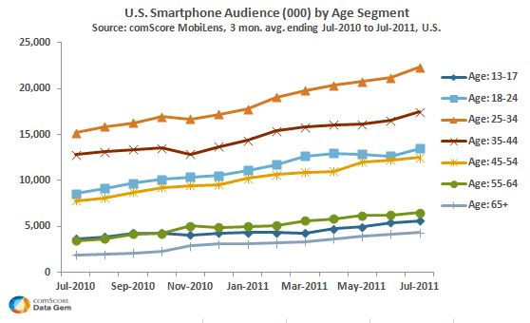
Background
Smartphone usage has increased x% per year for the last five years (source).
Office workers spend x% of their day outside of the office.
1-PAGER

Slide 20
Scenarios
Heidi is working on a slide deck for a client presentation. After leaving the office, she realizes she needs to make a small update before her presentation tomorrow.
1-PAGER

Slide 21
Feature List
List of recently accessed documents from all devices.
Ability to quickly navigate to older documents.
1-PAGER

Slide 22
Success Metrics
When user opens Office Hub, > 50% documents are found from recent documents list. (Hypothesis validation).
List is loaded and up to date within 500ms 90% of the time. (Performance)
1-PAGER

Slide 23
Why?
Get everyone on “one page” before starting.
Decide if you want to invest at all.
Prevent churn in your projects.
Know when you’ve succeeded.
Prevent scope creep.
1-PAGER

Slide 24
Scenarios

Slide 25
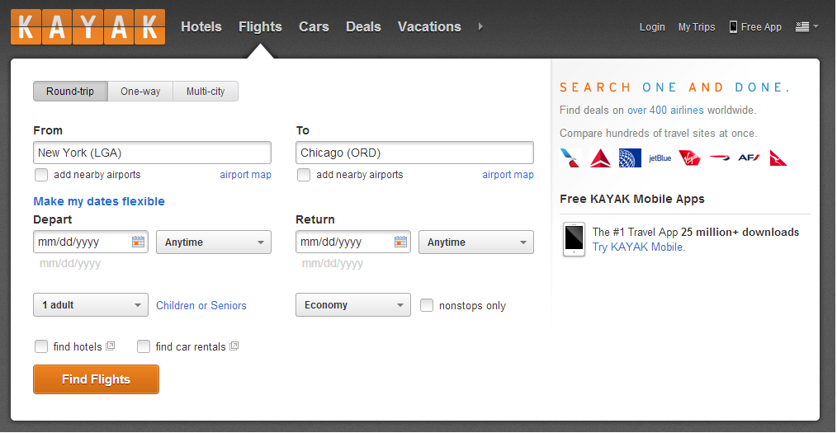
Talking about Scenarios
Is everyone familiar with Kayak?
SCENARIOS

Slide 26
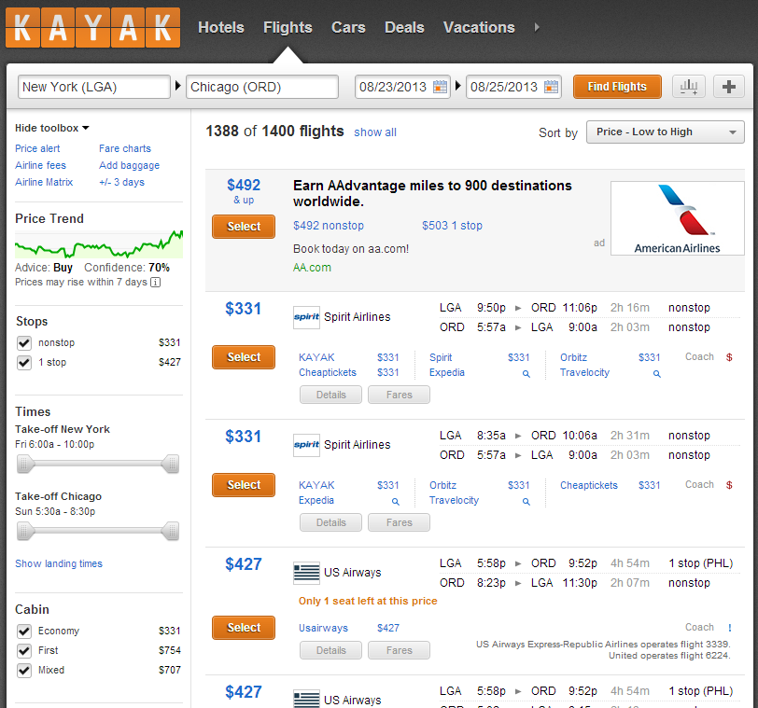

Slide 27
Who - Personas
Personas are specific personalities that you invent to talk about your users
They should be based in fact and represent real users
If you can, do research to identify what your users look like and base your personas on that
SCENARIOS

Slide 28

Kayak Scenario #1
Charlie wants to go visit his friend in Chicago. Due to their busy schedules, he has selected a specific weekend, and wants to travel Friday – Sunday. He would like to find, and then purchase, the cheapest flights he can on these specific days.
SCENARIOS

Slide 29
Other Kayak Scenarios
I want to go to <city> for a weekend, but I don’t care when. Find me the cheapest flight on any weekend.
I want to fly to <city> on specific dates, for as cheaply as possible, with no segments longer than 2 hours.
I’m flying for an interview (ie. not footing the bill), and want to find the best times for direct flights only (specific times, eg. not redeye, get in before 10pm, leave after 11am, etc.)
SCENARIOS

Slide 30
How?
Use specific user personas
Write a short story that talks about what users want to do with your product
Write the scenarios before discussing implementation or features
SCENARIOS

Slide 31
Why?
Helps you prioritize when you have lots of disparate requests
Reminds you who you’re building for
Remember: Users see end to end stories – not a list of features
SCENARIOS

Slide 32
Specifications

Slide 33
What is it?
Everything your team needs to build the feature.
SPECIFICATIONS

Slide 34
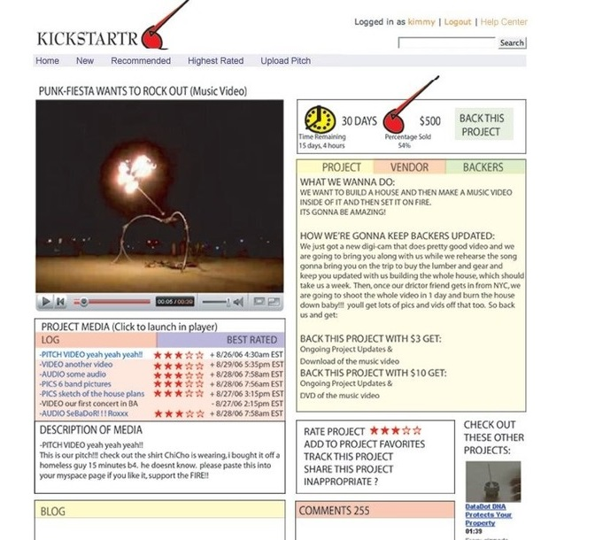
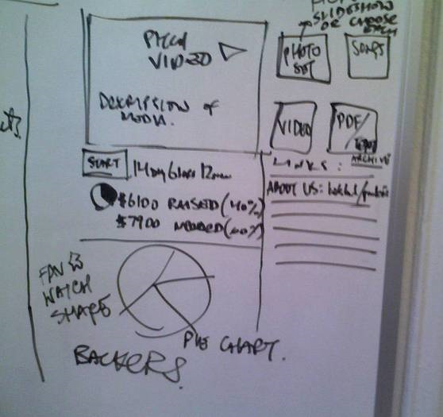
SPECIFICATIONS

Slide 35
Why?
What you build.
The “central point” for your whole team.
Helps you decide what to cut later on.
SPECIFICATIONS

Slide 36
Project Management

Slide 37
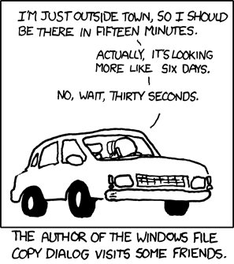
Estimation
It’s hard.
Don’t do it for your developers
Not everything is measured in “developer-days”
Estimate, Measure, Repeat
T-shirt sizing
Try Estimation Poker
PROJECT MANAGEMENT

Slide 38
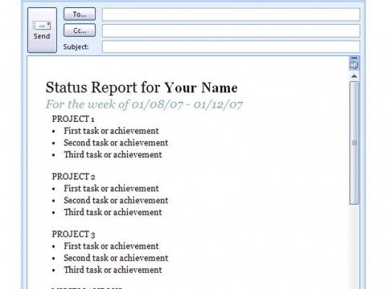

Communication
PROJECT MANAGEMENT

Slide 39
Scope Creep
One of the biggest problems in software development
Use your 1-pager
Keep a suggestion bin
Ask what they want to remove
PROJECT MANAGEMENT

Slide 40
Cutting
If you never ship, it doesn’t matter what features you have.
PROJECT MANAGEMENT

Slide 41
QA & Test

Slide 42
Context: Agile vs. Waterfall
Testing is built in to the Waterfall / SDLC methodology
Can be forgotten in a more Agile environment
“We’ll just push an update”
QA & TEST

Slide 43
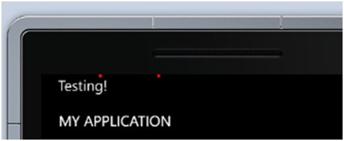
Functional Testing
Does it work?
Does it feel right?
QA & TEST

Slide 44
Edge Case Testing
Something out of your control
Can sometimes dictate new features
Make it acceptable failure
QA & TEST

Slide 45




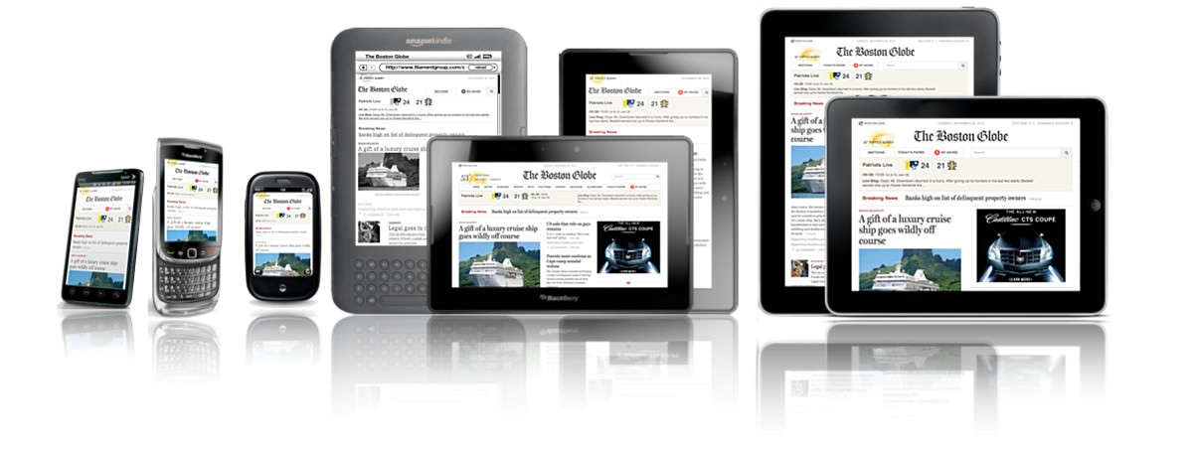

Standard Test Case Matrix
Browsers
Phones / tablets
Slow/fast internet
QA & TEST

Slide 46
Baseline Metrics
Performance
Automation
QA & TEST

Slide 47
Stabilization
Happens naturally in Waterfall-style development
QA & TEST

Slide 48
Why?
Better UX for your consumer
Prevent technical debt
QA & TEST

Slide 49
Recap!

Slide 50
Techniques
1-Pager
Scenarios
Specifications (Specs)
Project Management
Value of Quality Assurance (QA) and Test

Slide 51

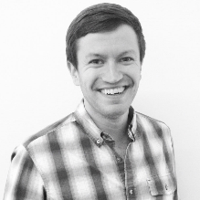
Thanks for coming
Ellen Chisa
@ellenchisa
ellen.chisa@gmail.com
Steven Benario
@sbenario
sbenario@gmail.com

Slide 52
Q & A
http://ellenchisa.com/feedback

